Slide 1

COLLEGE MANAGER
A Presentation for TCET's Employability Skill Development Program (ESD)
Atul Kumar Tiwari (18-EXTCB31-22)
Pragun Tiwari (18-EXTCB32-22)
Akash Jha (18-EXTCB16-22)

Slide 2
Flow of Presentation
Problem Statement
Description
Implementation
Discussion
Conclusion

Slide 3
Problem Statement
To develop a Spring MVC project that runs on Apache Tomcat Server. The web application should be dynamic. The web application should takes user’s login information and then grants access only after correct authentication.
The web application should be developed in such a manner that administrator should be able to perform CRUD application on the data that is added by the user.
The data that is added in the front end on the server should be stored in the backend server in the database. For each new session the data (or any changes on existing data) of the previous session should be reflected in the front end.

Slide 4
Description
College Management web application is divided into three major modules, viz. Login, Dashboard, Logout. All three modules provide different functions that can used by administrator.
COLLEGE MANAGEMENT SYSTEM
LOGIN
DASHBOARD
LOGOUT
ADD
VIEW LIST
EDIT

Slide 5
Implementation
Operating system | Windows, MacOs, Linux
IDE | Eclipse 2019-12 on JDK 1.8
Front end | Java, Java Servlet Page (JSP)
Backend | MySQL
Server | Apache Tomcat v 9.0
Web Browser | Google Chrome / Internet Explorer / Mozilla Firefox

Slide 6
Discussion
This project aimed at developing an Online College Management System that is of importance to an educational institution. The system is an Internet based application that can be accessed throughout the institution or a specified department. This system is being developed for college to maintain and facilitate easy access to information. For administrator, they needed to be registered with the system after which they can access or modify data as per the permissions given to them.

Slide 7
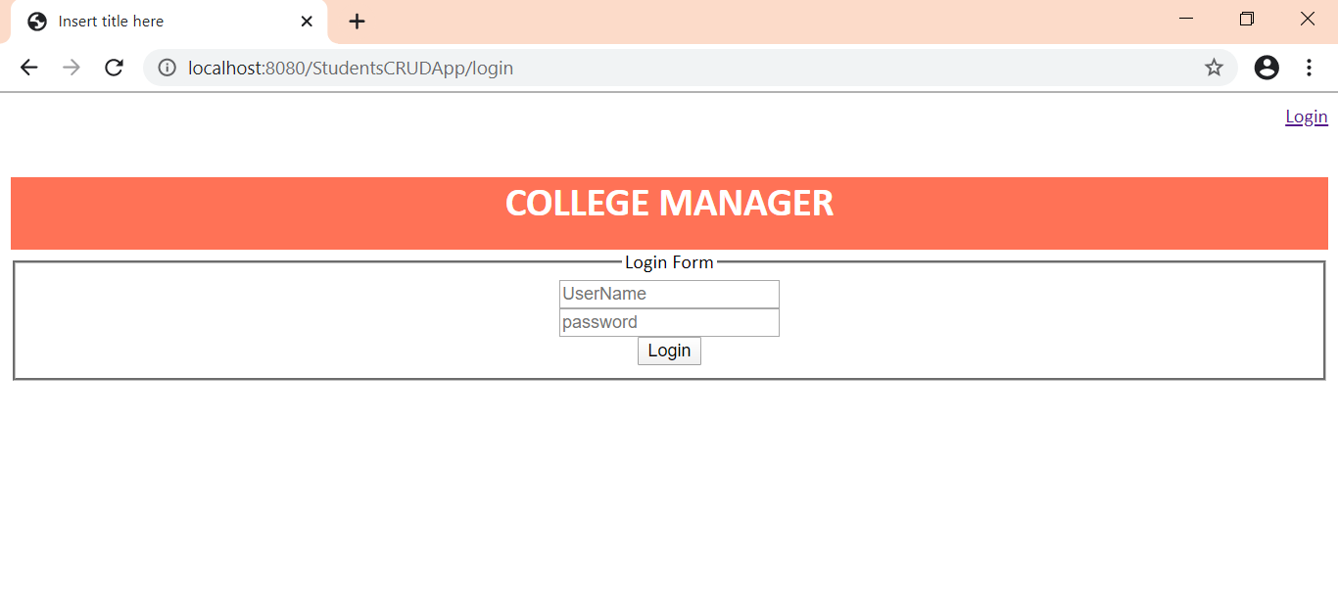
Result

Slide 8
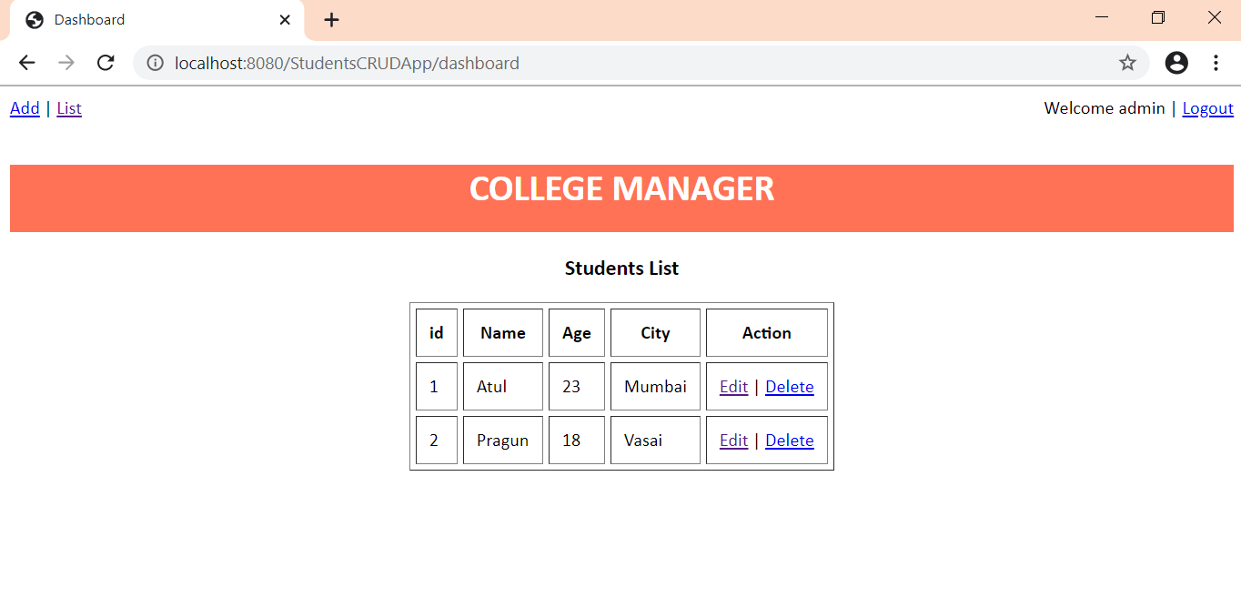

Slide 9
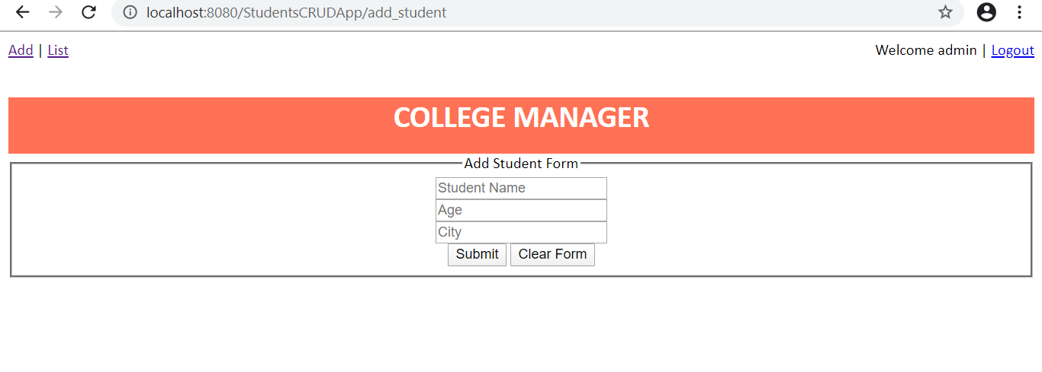
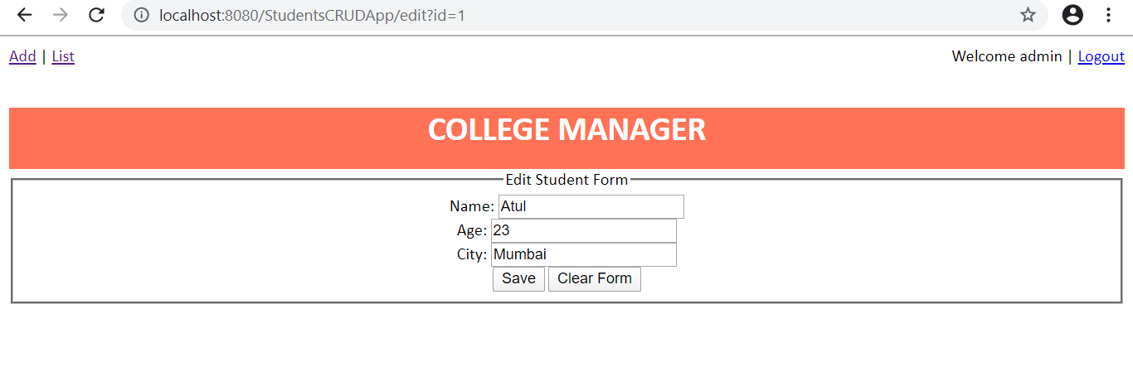

Slide 10
Conclusion
This project was successfully implemented with all the features mentioned in system requirements specification. Awareness and right information about any college is essential for both the development of student as well as faculty. So this serves the right purpose in achieving the desired requirements of both the community. The College Management System was implemented on MVC architecture. The Model layer was based on MySQL that was connected using JDBC and Hibernate to the front end which contained Views designed using JSP and CSS. The Controller has servlets stored in it and used HTTP Session Request and POST method.
The dynamic web application was tested on Apache Tomcat server . The web application was able to authenticate the login information, grant access to dashboard and gave the administrator method to perform CRUD operation on the database.

Slide 11
References
[1] Khawas Chunnu & Shah Pritam, “Database in Android App Development”, for International Journal of Computer Applications.
[2] Herbet Schildt, “Java The Complete Reference”, Eleventh Edition, New York, 2019.
[3] S. Marzic, I. Jugo and M. Radvon, “Developing ddynamic web applications: “Exam Scheduler”,” 2011 Proceedings of the 34th International Convention MIPRO, Opatija, pp. 1127-1132
[4] Mari Abe, Takashi Nermoe, Masahiro Hori, “Model Driven Development of Dynamic Web Applications”, for International Journal of Computer Applications, 2002.
[5] D Guell, N Schewabe, “ Modelling Interactions and Navigation in Web Applications”, vol. 1921, pp. 115-127. Springer, Heidelberg (200).
[6] JavaTPoint, Spring Tutorial, https://www.javatpoint.com/spring.

Slide 12
THANK YOU

